Slide 1
Crime in Boston
Anshuman Singh Dikhit
Arash Nezam Saramadi
Kislay Kumar
Nitesh Kumar
CS 109A | Dec 10th, 2021 | Fall 2021

Slide 2
Project goal
Analyze and model the crime in Boston area using Boston Crime Incident Reports

Slide 3
Data used in analysis
Boston Crime Incident Reports
Neighborhood demographic data
Streetlight data
Weather Data

Slide 4
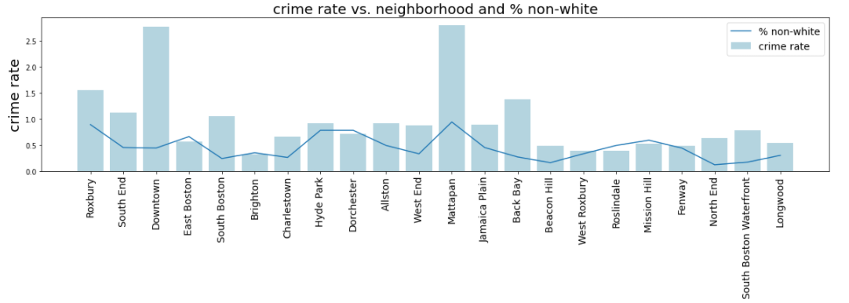
EDA – Race and Crime

Slide 5
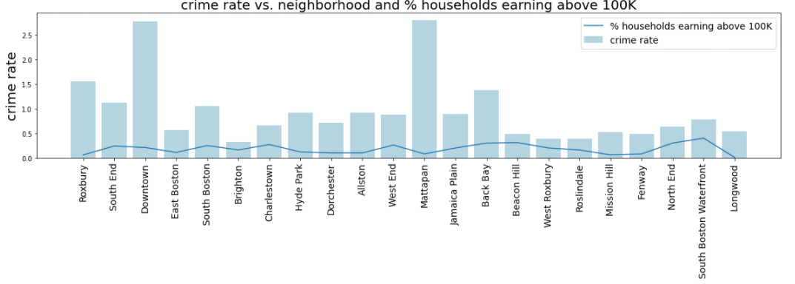
EDA – Income and Crime

Slide 6
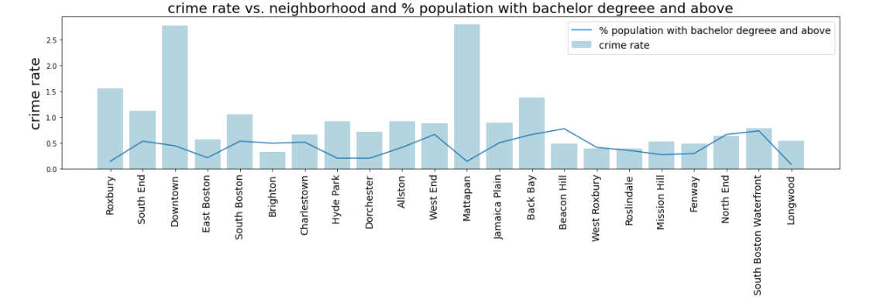
EDA – Education and Crime

Slide 7
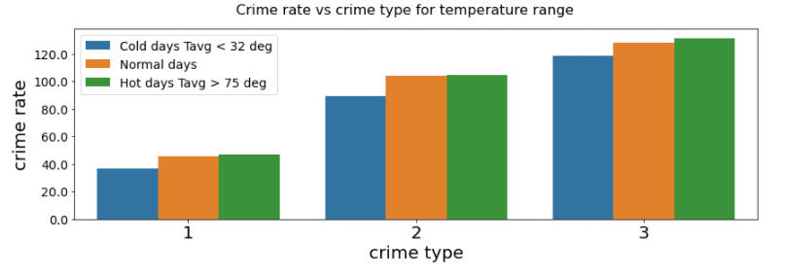
EDA – Weather and Crime

Slide 8
Research question
What factors both socio-economic and non-socio-economic, can help us best categorize and identify the severity of crimes, defined as part of UCR?
Uniform Crime Report (UCR) definitions are as follows:
Part 1: For violent crime such as homicide, rape, murder etc.
Part 2: For less severe crimes such as assault without aggravation, forgery, fraud etc.
Part 3: For all other crimes that do not fall under Part 1 or Part 2.

Slide 9
Model
Predictors: Demographic information (socio-economic), Weather, Time and Streetlight information
Response: Crime type defined by Uniform Crime Reporting (UCR)
Models explored:
Naïve model
Base model – Logistic regression
LASSO like Logistic regression
Decision Tree
Adaboost
Random Forest

Slide 10
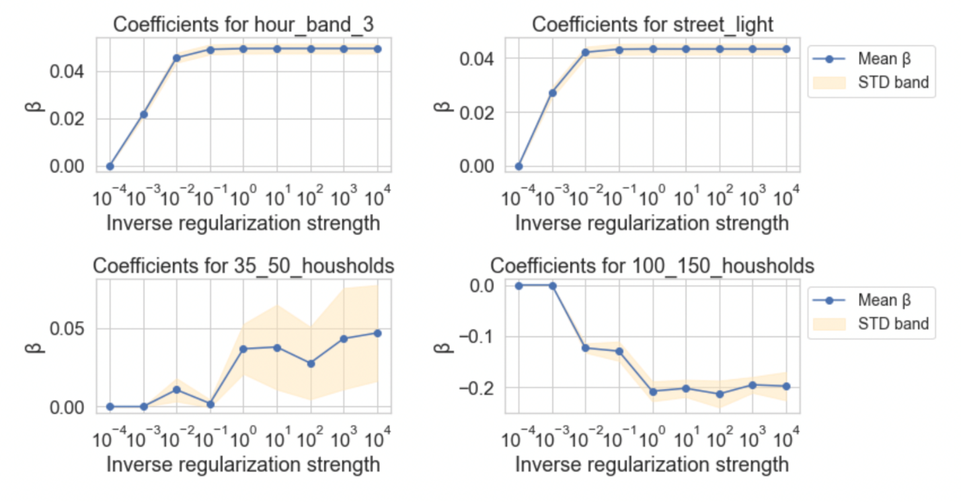
Model Selection and Hyperparameter tuning
Logistic Regression

Slide 11
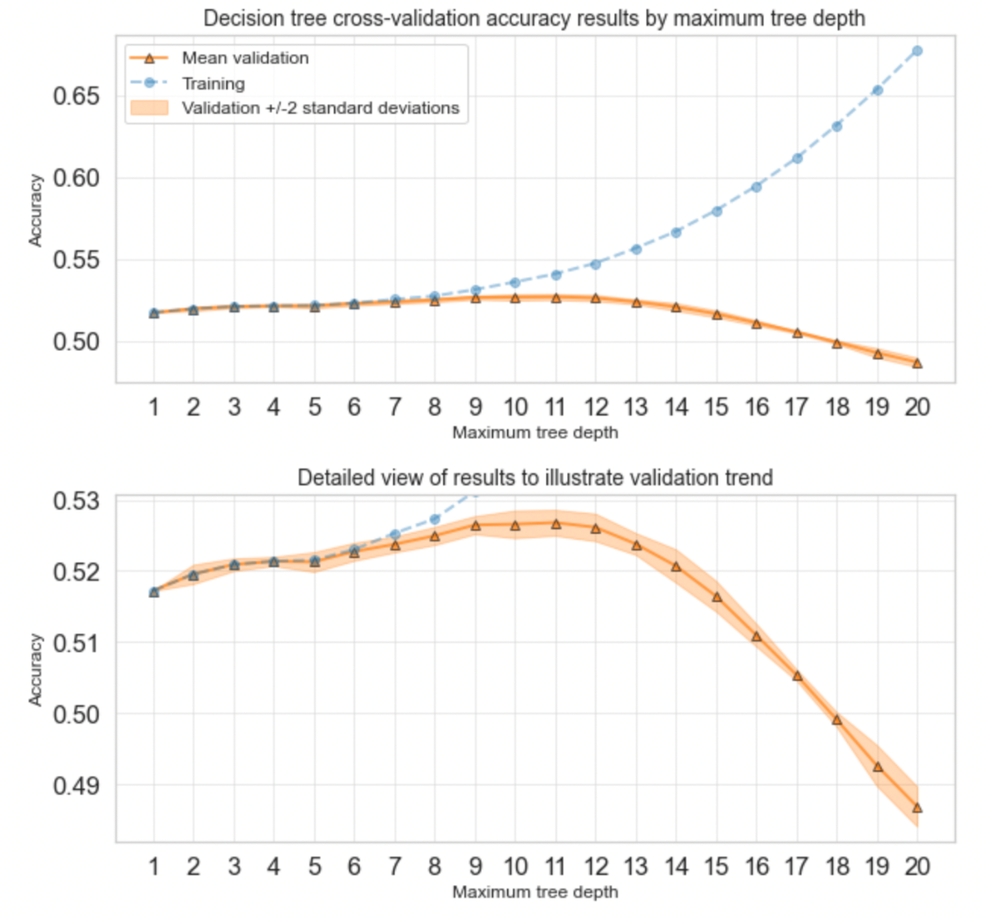
Model Selection and Hyperparameter tuning
Decision Tree

Slide 12
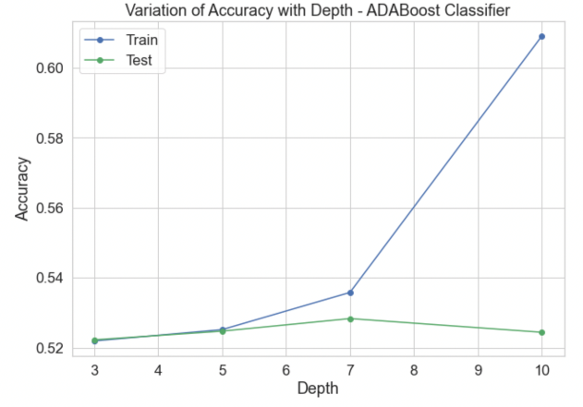
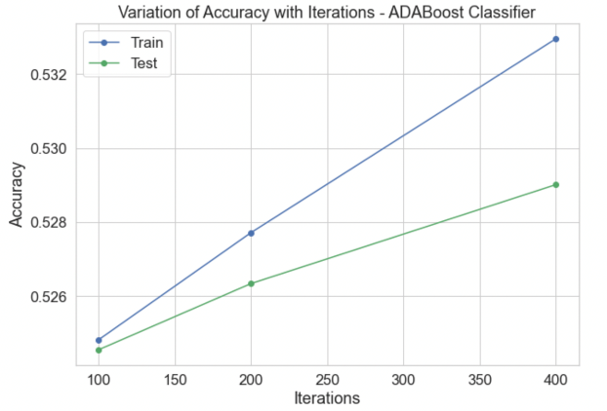
Model Selection and Hyperparameter tuning
Boosting

Slide 13
Model Selection and Hyperparameter tuning
Random Forest
Ensembled Model (Logistic Regression + Adaboost + Balanced Random Forest)

Slide 14
Model Performance and Limitations
Model | Accuracy % | AUC Score
Naïve | 51.72 | -
Base Logistic Regression | 52.12 | 0.5716
Logistic Regression with Lasso | 51.72 | 0.5591
Single Decision Tree | 52.47 | 0.5577
Balanced Random Forest | 47.04 | 0.5862
AdaBoost | 52.60 | 0.5951
Our own Ensemble Model | 52.60 | -

Slide 15
Model Interpretation
Feature importance
Permutation importance
Exploratory data analysis on model output

Slide 16
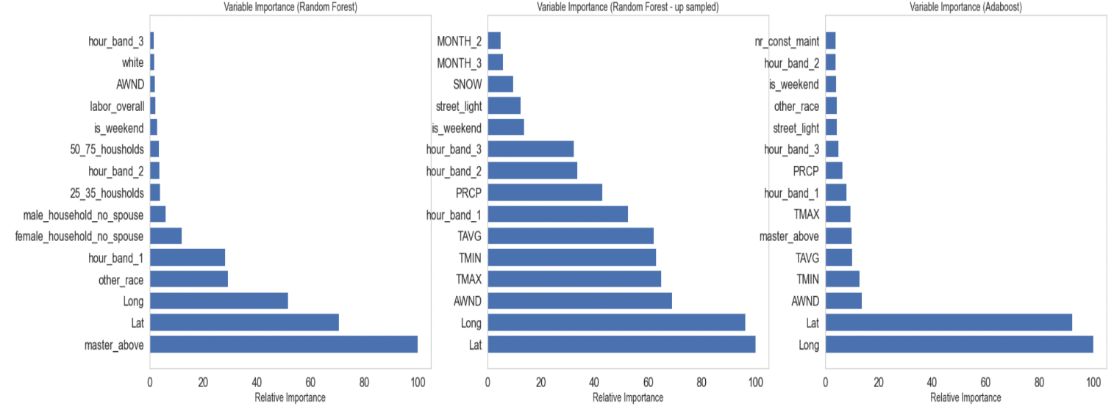
Model Interpretation
Feature importance
Decision Tree
Random Forest
Adaboost

Slide 17
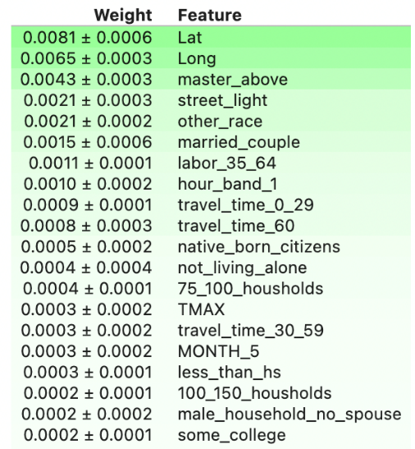
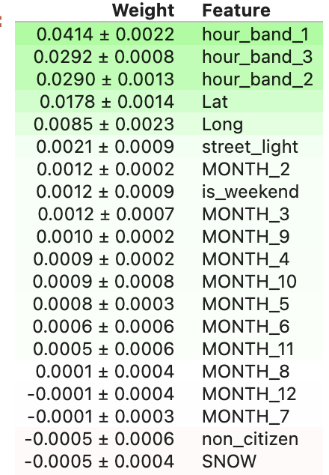
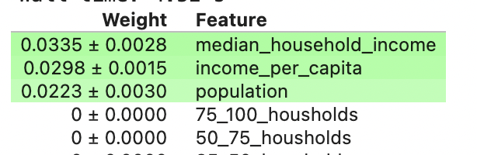
Model Interpretation
Permutation importance
Adaboost
Random Forest
Logistic regression

Slide 18
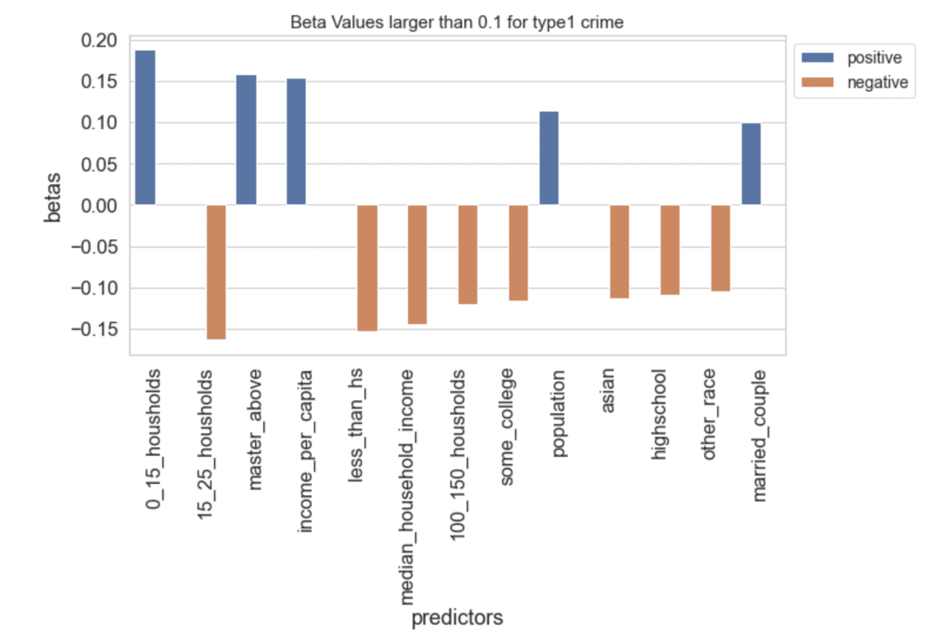
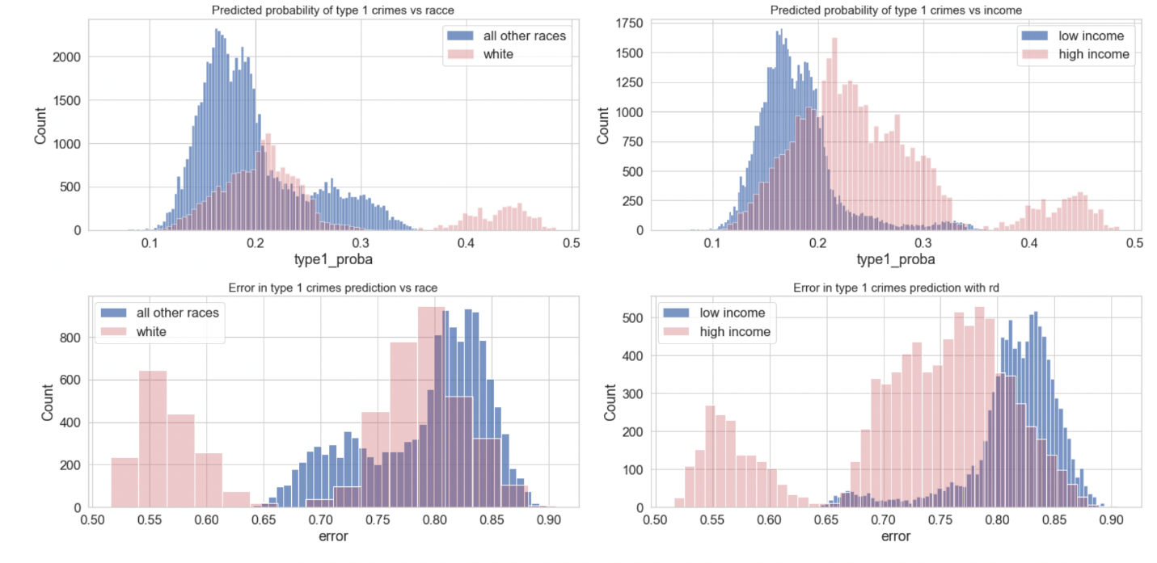
Model Interpretation

Slide 19
Findings and Conclusion
Based on EDA it appeared that socio-economic factors influences crime
Availability of socio-economic predictors only at neighborhood level (Only 22 unique datapoints)
Most of the predictors are correlated, so limited additional information provided to model.
Only location and time information available from crime incidents
Model performance cannot be significantly improved if there are such limitations with the predictors.

Slide 20
Thank you!

